Slide 1

Mastering Options With Insta Options
EXPLORE - UNDERSTAND - EXECUTE
20th Feb’26
Disclaimer
This is for educational and informational purposes only and does not constitute financial advice. Refer - https://stocko.in/stocko-disclaimer/
Private & Confidential. Please do not circulate.

Slide 2
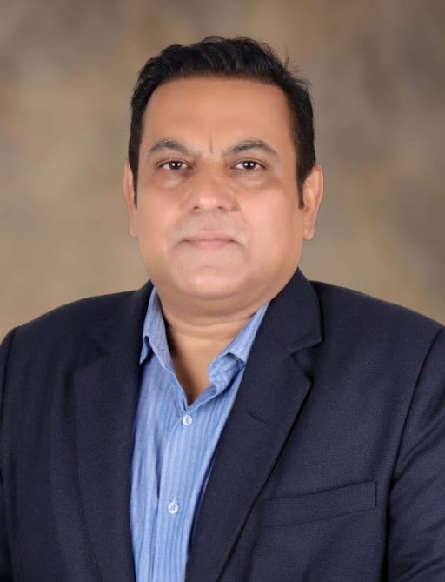
Presenter Hitesh Chotalia
Market Experience : 26 Years
Technical Market Strategist : Share khan
Asia Pacific Equity Research : Citi Global Markets
Technical Market Strategist : Centrum Broking
Product Head : Ignite – Sharekhan Education
Sr VP : Motilal Oswal : Head School Of Trading & Investing
Head Education : Fin Learn Academy
Media Appearance : CNBC & NDTV Profit

Slide 3

Options Trading
Four fundamental pillars of options trading:
Data Visualization
One Click Execution
Analytics
Custom Strategies
Notes:
Add source, change framing

Slide 4
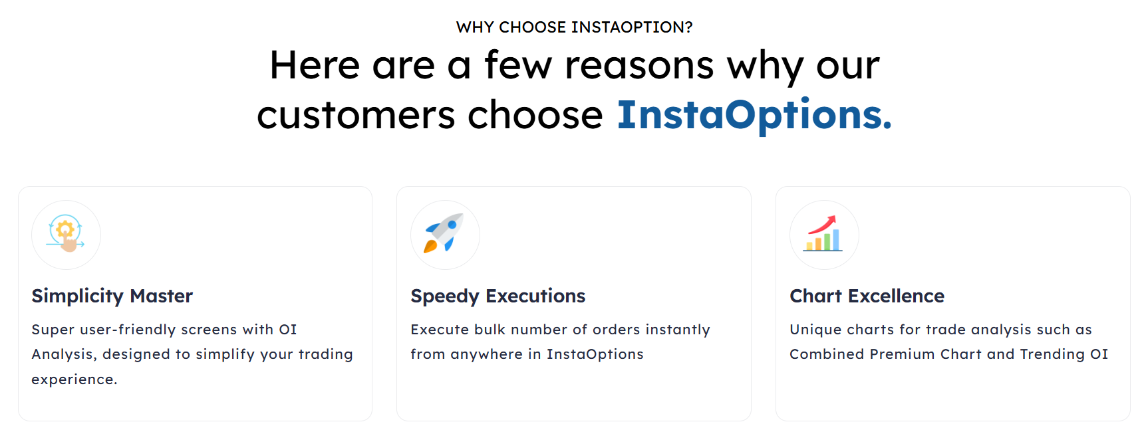
Insta Options: Primary Features
Option Data
Strategy
Strategy Payoff
1 Click Execution
Notes:
Add source, change framing

Slide 5
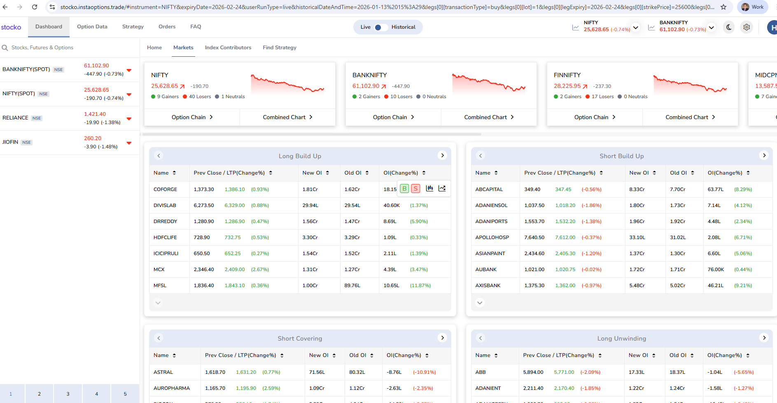
Introduction to InstaOptions
Notes:
Add source, change framing

Slide 6
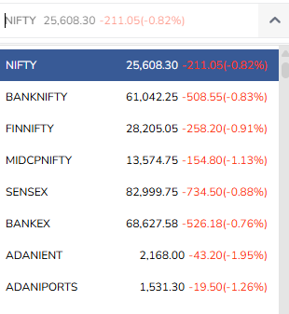
InstaOptions: Option Data
Indices & Stocks
Option Chain
OI Statistics
Trending OI
PCR (Put Call Ratio)
Options Chart
Notes:
Add source, change framing

Slide 7

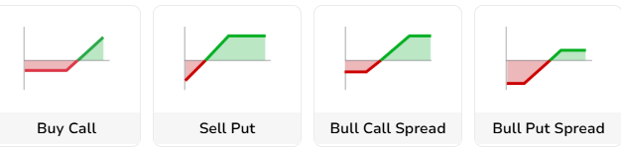
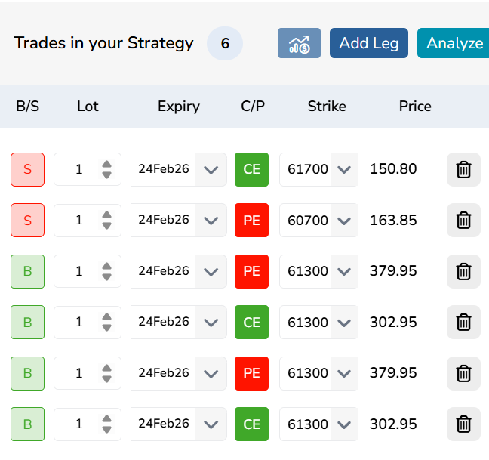

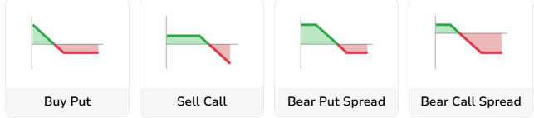

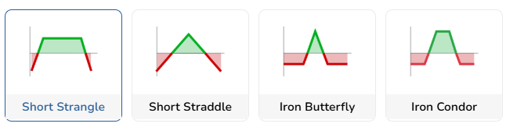
Options Strategies
Notes:
Add source, change framing

Slide 8
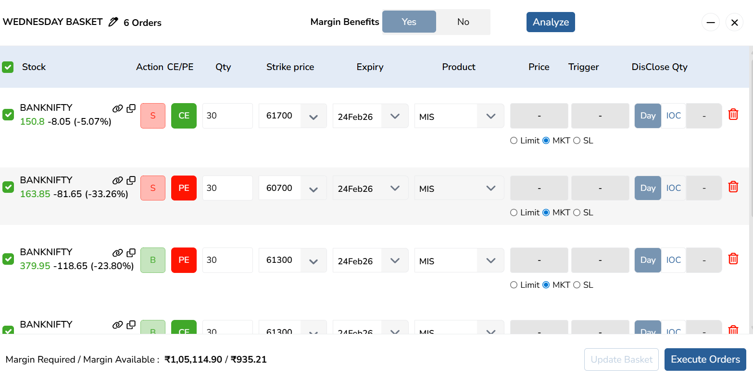
One Click Execution
Strategy Creation
1 Click : Multi leg execution
Notes:
Add source, change framing

Slide 9
Q&A

Slide 10
Disclaimer
Investments in the securities market are subject to market risks,read all the related documents carefully before investing. Brokerage will not exceed the SEBI prescribed limit.
Any video/image/text content is for educational and informational purposes only and does not constitute financial
advice. Please do your own research or consult a qualified financial advisor before making any investment or trading decisions. Trading in stock markets involves risk of loss.
South Asian Stocks Ltd. : NSE Member Code 09073, BSE
Member Code 6329, MCX Member Code : 55215 , NCDEX
Member Code : 1233 NSDL : IN-DP-474-2020 . SEBI Registration
No. INZ000164738
Compliance Officer: NSE, BSE,MCX,NCDEX,NSDL : Mr RK
Jain , 011-40409999 support@stocko.in
Registered Office:- 3rd Floor, Building No.5, Local Shopping
Complex, Rishabh Vihar, Near Karkarduma Metro Station. East
Delhi – 110092

