Slide 1

EXPLORE - UNDERSTAND - EXECUTE
Double & Triple Candle Pattern
24th Feb’26
Disclaimer
Disclaimer: Investment in securities market are subject to market risks, read all the related documents carefully before investing. Brokerage will not exceed the SEBI prescribed limit.
Private & Confidential. Please do not circulate.

Slide 2

Presenter Hitesh Chotalia
Market Experience : 26 Years
Technical Market Strategist : Share khan
Asia Pacific Equity Research : Citi Global Markets
Technical Market Strategist : Centrum Broking
Product Head : Ignite – Sharekhan Education
Sr VP : Motilal Oswal : Head School Of Trading & Investing
Head Education : Fin Learn Academy
Media Appearance : CNBC & NDTV Profit

Slide 3
Candle Type: Double-Candle
Bullish Engulfing
Bullish Reversal
First candle has a filled red real body, in line with the downtrend
The second candle's open is below the previous candle body
The second candle's body engulfs the previous candle's real body
The shadow of the candle is insignificant
Its an Expanded Range Candle (ERC)
Bullish engulfing candle appears in a downtrend

Slide 4
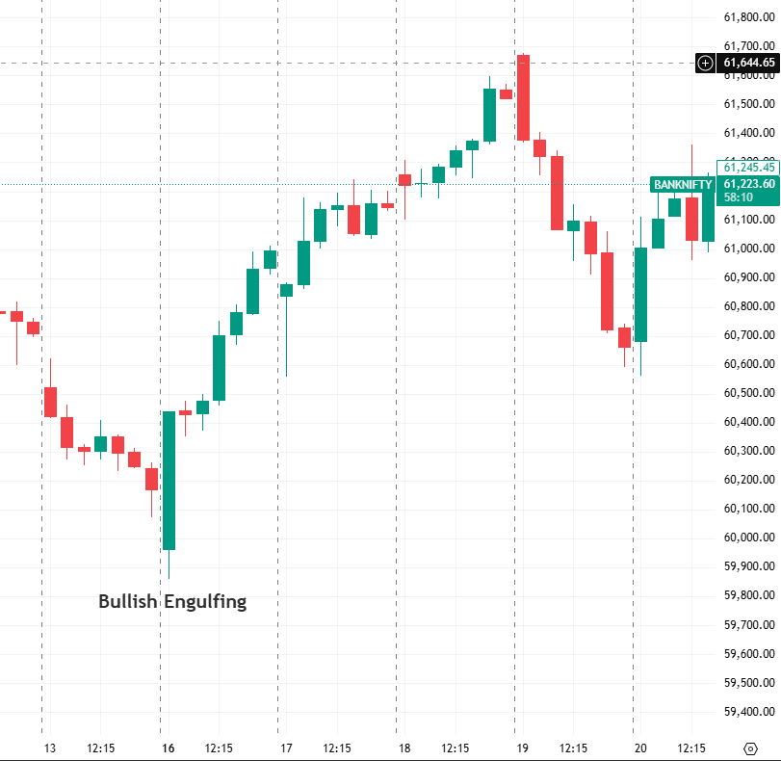
Candle Type: Double-Candle
Bullish Engulfing
Bullish Reversal
First candle has a filled red real body, in line with the downtrend
The second candle's open is below the previous candle body
The second candle's body engulfs the previous candle's real body
The shadow of the candle is insignificant
Its an Expanded Range Candle (ERC)
Bullish engulfing candle appears in a downtrend
Significance in a sideways consolidation

Slide 5
Candle Type: Double-Candle
Bearish Engulfing
Bearish Reversal
First candle has a real body (green) ,within the uptrend
The second candle's open is above the previous candle's body
The second candle's body engulfs the previous candle's body
The shadow of the candle is not relevant
Location : appears in an uptrend
Bearish engulfing indicates high in place

Slide 6
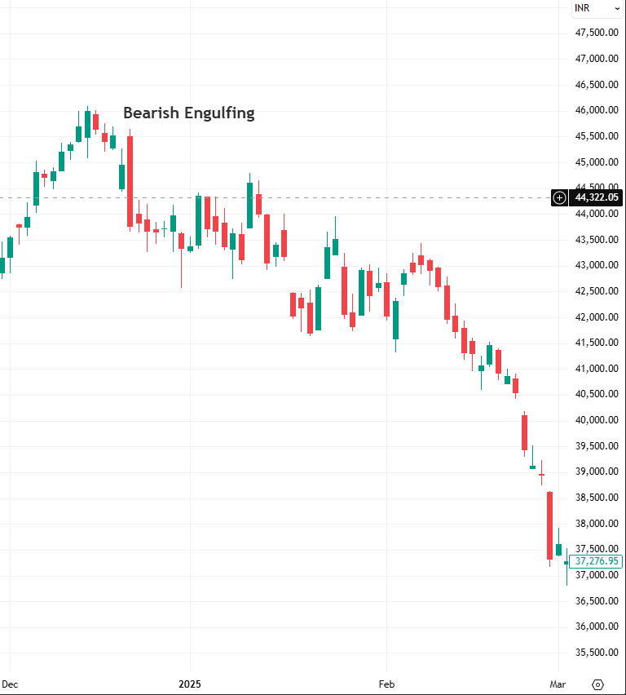
Candle Type: Double-Candle
Bearish Engulfing
Bearish Reversal
First candle has a real body (green) ,within the uptrend
The second candle's open is above the previous candle's body
The second candle's body engulfs the previous candle's body
The shadow of the candle is not relevant
Location : appears in an uptrend
Bearish engulfing indicates high in place

Slide 7
Candle Type: Double-Candle
Dark Cloud Cover
Bearish Reversal
First candle has a filled body , in the context of the uptrend
First candle color is green
The next candle's price gaps up on the open
The second candle has a large filled body (Red)
The second candle's body closes below the 50% mark of the previous candle's body
Location : Dark Cloud Cover appears in an uptrend

Slide 8
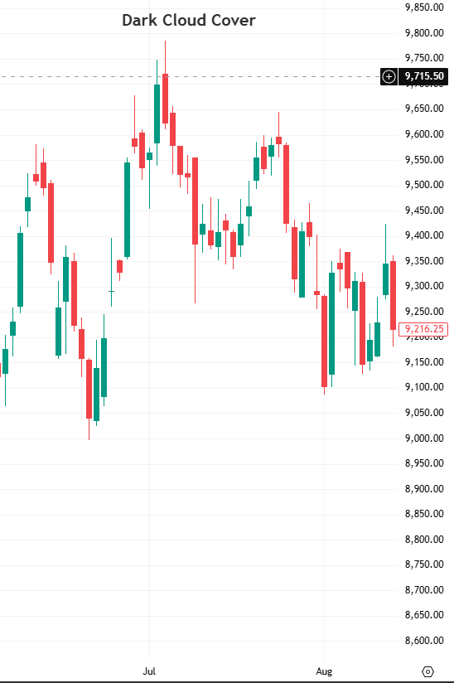
Candle Type: Double-Candle
Dark Cloud Cover
Bearish Reversal
First candle has a filled body , in the context of the uptrend
First candle color is green
The next candle's price gaps up on the open
The second candle has a large filled body (Red)
The second candle's body closes below the 50% mark of the previous candle's body
Location : Dark Cloud Cover appears in an uptrend

Slide 9
Candle Type: Double-Candle
Bullish Piercing
Bullish Reversal
First candle has a filled body in the downtrend (Red)
The next candle's price gaps lower on open of the second candle
The second candle's body closes above 50 % level of the first candle's real body
Bullish piercing appears in a downtrend indicating a low in place
Location : Bullish piercing appears in a downtrend

Slide 10
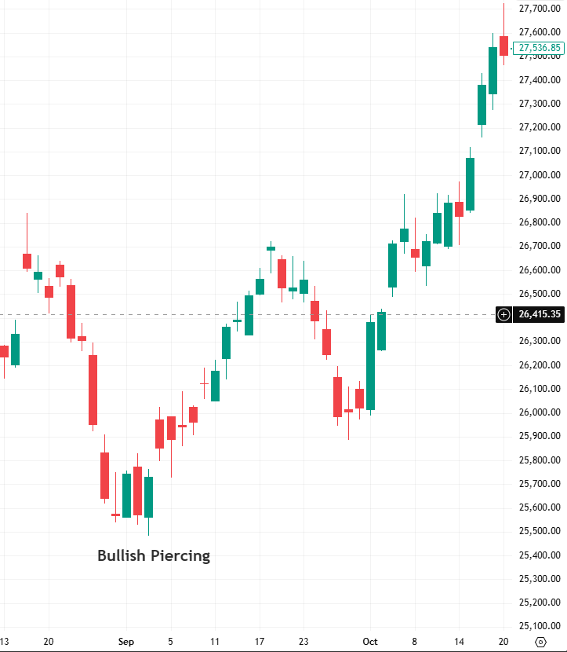
Candle Type: Double-Candle
Bullish Piercing
Bullish Reversal
First candle has a filled body in the downtrend (Red)
The next candle's price gaps lower on open of the second candle
The second candle's body closes above 50 % level of the first candle's real body
Bullish piercing appears in a downtrend indicating a low in place
Location : Bullish piercing appears in a downtrend

Slide 11
Candle Type: Double-Candle
Bullish Harami
Bullish Reversal
First candle has a filled body in the downtrend (Red)
The next candle's real body is within the first candle
The second candle's body is small
The second candle's real body appears like a Doji candle
Location : Bullish Harami appears in a downtrend signaling a low in place

Slide 12
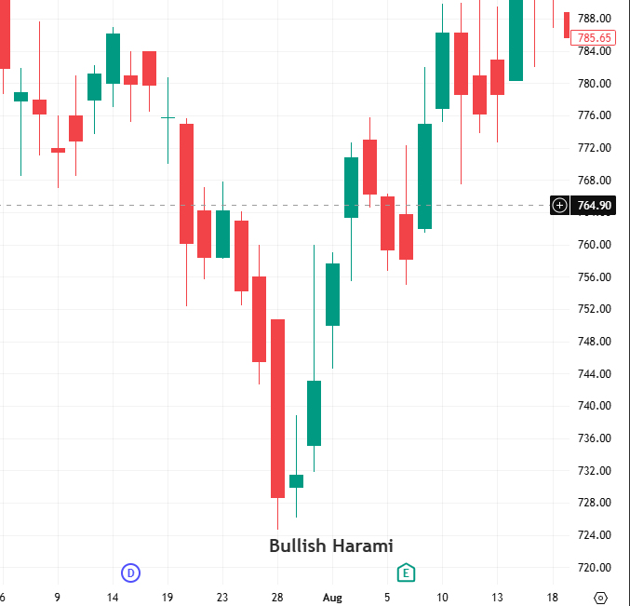
Candle Type: Double-Candle
Bullish Harami
Bullish Reversal
First candle has a filled body in the downtrend (Red)
The next candle's real body is within the first candle
The second candle's body is small
The second candle's real body appears like a Doji candle
Location : Bullish Harami appears in a downtrend signaling a low in place

Slide 13
Candle Type: Double-Candle
Bearish Harami
Bearish Reversal
The first candle has a real body with the uptrend (Green)
The second candle's real body is within the first candle's real body
Bearish Harami appears in an uptrend
Suggests a high is in place

Slide 14
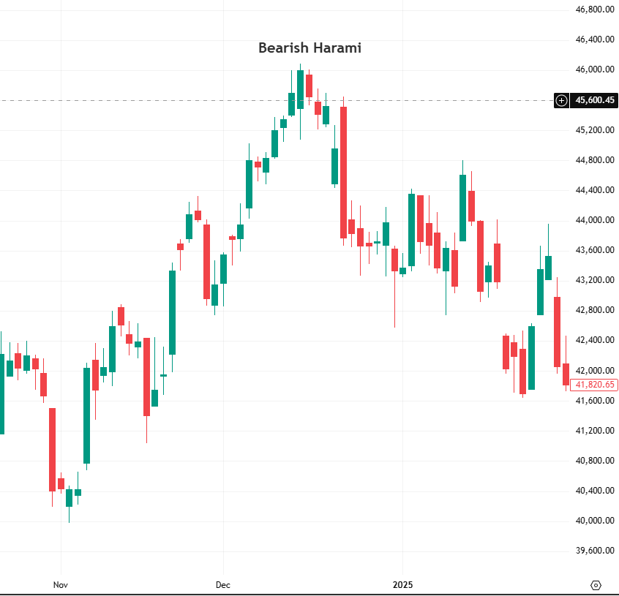
Candle Type: Double-Candle
Bearish Harami
Bearish Reversal
The first candle has a real body with the uptrend (Green)
The second candle's real body is within the first candle's real body
Bearish Harami appears in an uptrend
Suggests a high is in place

Slide 15
Candle Type: Three-Candle
Evening Star
Bearish Reversal
The first candle has a real body with the uptrend (Green)
The second candle's price gap up on the open of second candle
Second candle has a small real body
Color of second candle's body is not significant
The third candle's price gap down on open and closes below 50 % mark of the first candle
Evening star appears in an uptrend indicating high is in place

Slide 16
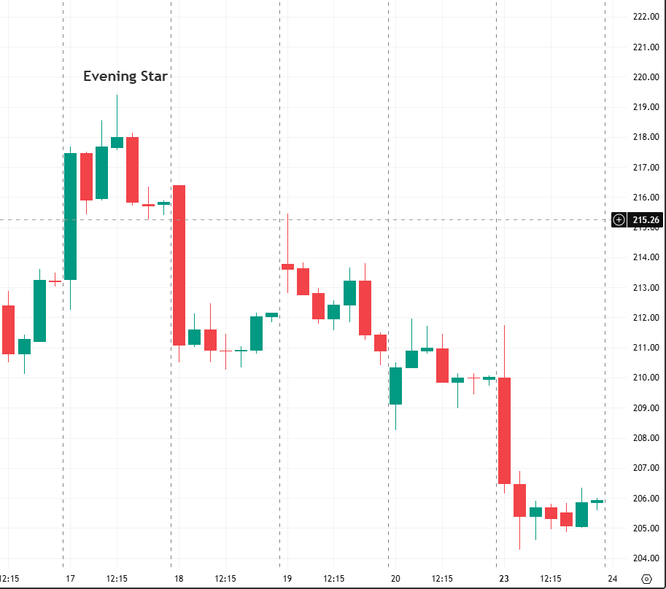
Candle Type: Three-Candle
Evening Star
Bearish Reversal
The first candle has a real body with the uptrend (Green)
The second candle's price gap up on the open of second candle
Second candle has a small real body
Color of second candle's body is not significant
The third candle's price gap down on open and closes below 50 % mark of the first candle
Evening star appears in an uptrend indicating high is in place

Slide 17
Candle Type: Three-Candle
Morning Star
Bullish Reversal
The first candle has a real body with the downtrend (Red)
The second candle's price gap down on the open of second candle
Second candle has a small real body
Color of second candle's body is not significant
The third candle's price gap up on open and closes above 50% mark of the first candle
Morning star appears in a downtrend indicating a low is in place

Slide 18
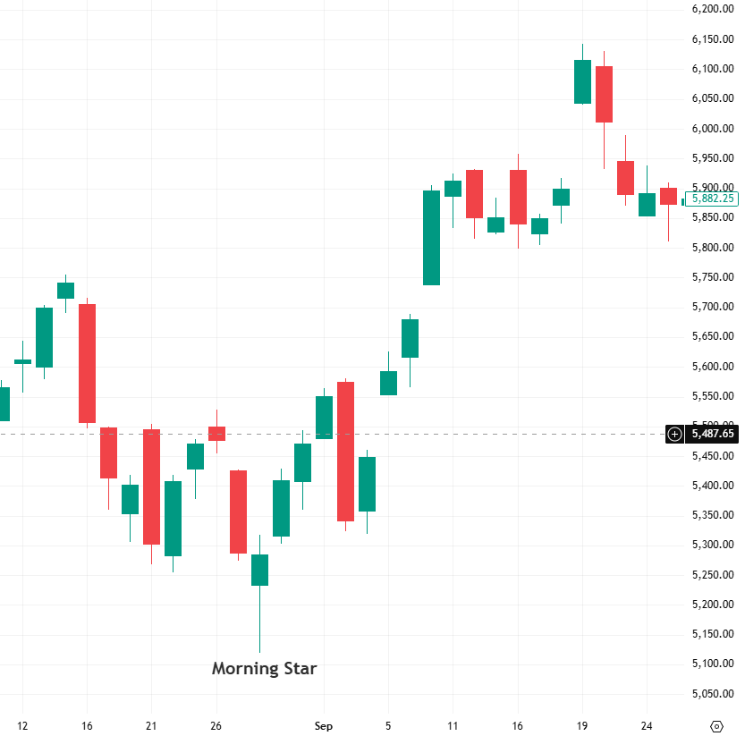
Candle Type: Three-Candle
Morning Star
Bullish Reversal
The first candle has a real body with the downtrend (Red)
The second candle's price gap down on the open of second candle
Second candle has a small real body
Color of second candle's body is not significant
The third candle's price gap up on open and closes above 50% mark of the first candle
Morning star appears in a downtrend indicating a low is in place

Slide 19
Candle Type: Three-Candle
Three White Soldiers
Bullish Reversal
The first candle is a green bullish candle
The second candle is a green bullish candle
The third candle is a green bullish candle

Slide 20
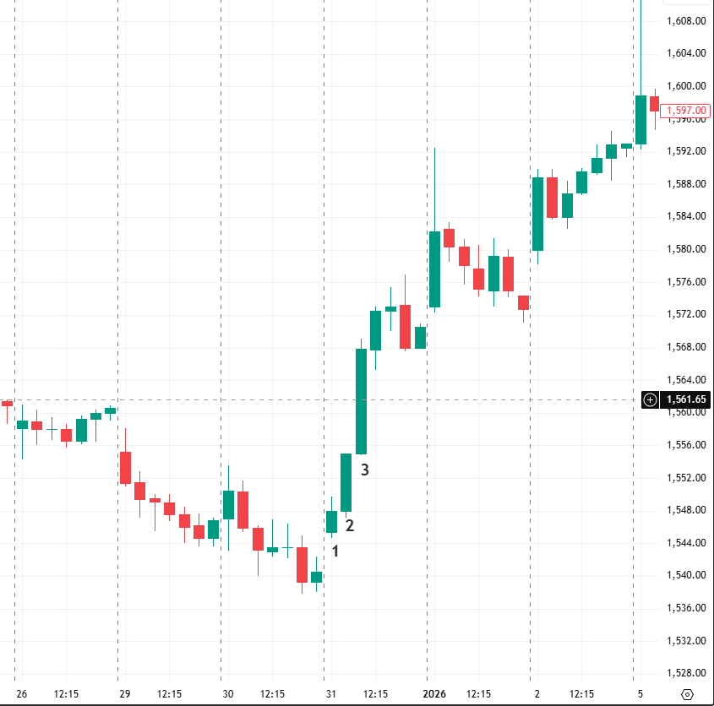
Candle Type: Three-Candle
Three White Soldiers
Bullish Reversal
The first candle is a green bullish candle
The second candle is a green bullish candle
The third candle is a green bullish candle

Slide 21
Candle Type: Three-Candle
Three Black Crows
Bearish Reversal
The first candle is a red bearish candle
The second candle is a red bearish candle
The third candle is a red bearish candle

Slide 22
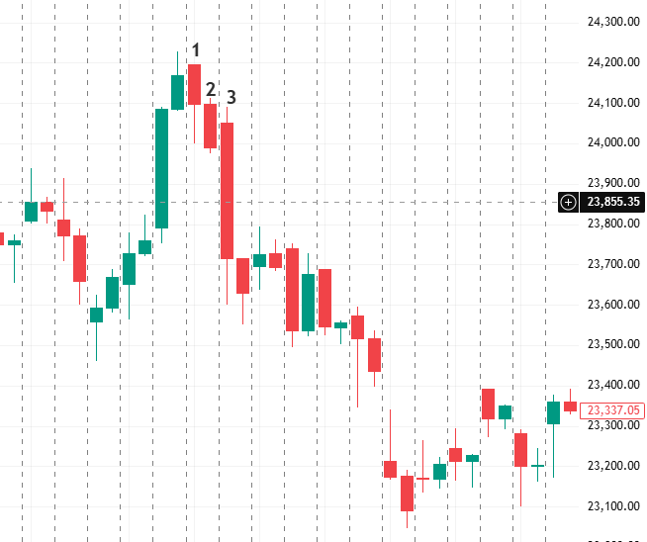
Candle Type: Three-Candle
Three White Soldiers
Bullish Reversal
The first candle is a green bullish candle
The second candle is a green bullish candle
The third candle is a green bullish candle

Slide 23
Q&A

Slide 24
Disclaimer
Investments in the securities market are subject to market risks,read all the related documents carefully before investing. Brokerage will not exceed the SEBI prescribed limit.
Any video/image/text content is for educational and informational purposes only and does not constitute financial
advice. Please do your own research or consult a qualified financial advisor before making any investment or trading decisions. Trading in stock markets involves risk of loss.
South Asian Stocks Ltd. : NSE Member Code 09073, BSE
Member Code 6329, MCX Member Code : 55215 , NCDEX
Member Code : 1233 NSDL : IN-DP-474-2020 . SEBI Registration
No. INZ000164738
Compliance Officer: NSE, BSE,MCX,NCDEX,NSDL : Mr RK
Jain , 011-40409999 support@stocko.in
Registered Office:- 3rd Floor, Building No.5, Local Shopping
Complex, Rishabh Vihar, Near Karkarduma Metro Station. East
Delhi – 110092

