Slide 1

EXPLORE - UNDERSTAND - EXECUTE
Options : Directional Hedged Strategies
17th Feb’26
Disclaimer
Disclaimer: Investment in securities market are subject to market risks, read all the related documents carefully before investing. Brokerage will not exceed the SEBI prescribed limit.
Private & Confidential. Please do not circulate.

Slide 2

Presenter Hitesh Chotalia
Market Experience : 26 Years
Technical Market Strategist : Share khan
Asia Pacific Equity Research : Citi Global Markets
Technical Market Strategist : Centrum Broking
Product Head : Ignite – Sharekhan Education
Sr VP : Motilal Oswal : Head School Of Trading & Investing
Head Education : Fin Learn Academy
Media Appearance : CNBC & NDTV Profit

Slide 3

Overview of Today’s Webinar
Options : Debit / Credit
Options Debit Strategies
Bull Call
Bull Call Spread
Bear Put
Bear Put Spread
Notes:
Add source, change framing

Slide 4
Overview of Today’s Webinar
• When to use Bull Call Spread vs Bear Put Spread
• Strategy construction and payoff understanding
• Ideal market conditions for each spread
• Risk, reward & breakeven analysis
• Common mistakes traders make with directional spreads
Notes:
Add source, change framing

Slide 5
Debit - Credit
Risk = Limited
Reward : Unlimited
Risk = Unlimited
Reward : Limited
Risk = Limited
Reward : Unlimited
Risk = Unlimited
Reward : Limited
Pay = Debit
Receive = Credit
Pay = Debit
Receive = Credit
Price Up
Call Up
Put Dn
Put Up
Call Dn
+ CE
- PE
Price Dn
- CE
+ PE
Buy
Sell
Buy
Sell
Notes:
Add source, change framing

Slide 6
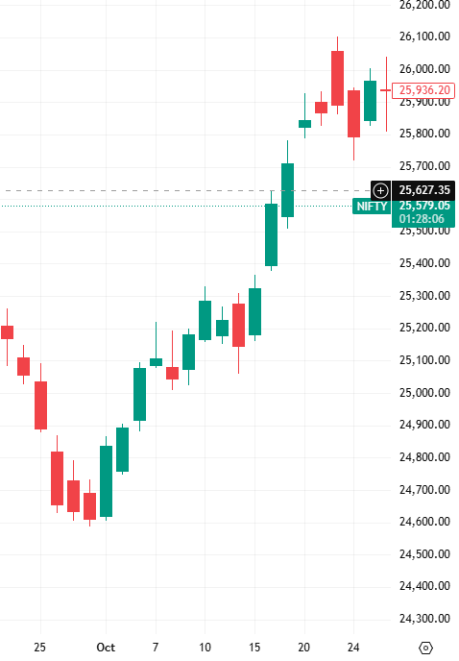
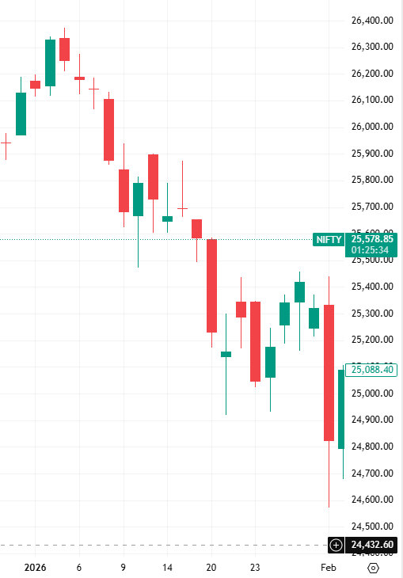
Debit – Buy Call – Buy Put
Pay = Debit
Pay = Debit
Buy 25400 CE
Buy 25400 PE
Price Up
Call Up
+ CE
Price Dn
Put Up
Buy
+ PE
Buy
Notes:
Add source, change framing

Slide 7
Bull Call Spread
View : Bullish on indices / stocks
Strategy : Buy OTM 1 CE & Sell OTM 4 CE
Risk : Limited to net premium
Reward : Limited to the difference between the two strikes minus net premium
Breakeven : Net premium paid + Strike price of call
Max Profit : Both options exercised
Max Loss : When both options unexercised
Notes:
Add source, change framing

Slide 8
Moneyness - Out Of Money (CE : OTM)
OTM 4
OTM 3
OTM 2
OTM 1
OTM 4
OTM 3
OTM 2
OTM 1
Call Option
935
930
925
920
O
T
M
Expires @ 0.05 paisa
Above
CMP = ATM
ITM 1
ITM 2
ITM 3
ITM 4
ITM 1
ITM 2
ITM 3
ITM 4
HDFC BANK CMP = 916= ATM = 915
Below
910
905
900
895
HDFC Bank Strike Interval = 5
Notes:
Add source, change framing

Slide 9
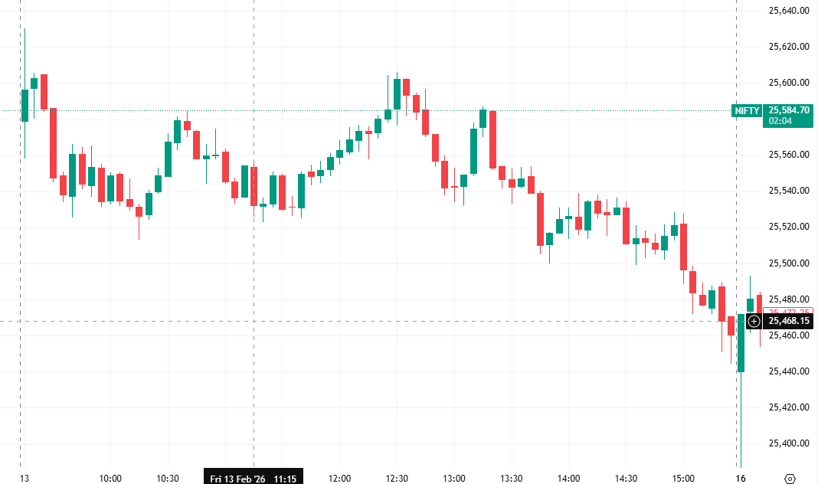
Debit Spread : Bull Call Spread
Strategy:
Bull Call Spread :
Hedge (Sell) : OTM 6 CE
Buy : OTM 2 CE
25650
Sell CE 25750 @ 30 (Hedge Leg)
25550
Buy CE 25550 @ 60 (Trade Leg)
CMP = 25300
Spread : 60 – 30 = 30 (Net Debit)
Max Risk = 30
Notes:
Add source, change framing

Slide 10
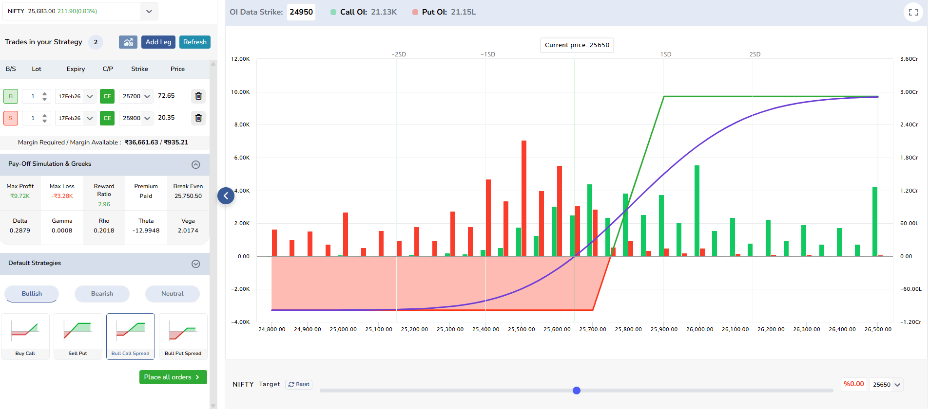
Bull Call Spread : Payoff Chart
Notes:
Add source, change framing

Slide 11
Bear Put Spread
View : Bearish on indices / stocks
Strategy : Buy OTM 1 PE & Sell OTM 4 PE
Risk : Limited to net premium (Net Debit)
Reward : Limited to the difference between the two strikes minus net premium
Breakeven Strike price of Buy Put - Net premium paid
Max Profit : Both options exercised
Max Loss : When both options unexercised
Notes:
Add source, change framing

Slide 12
Moneyness - Out Of Money (PE : OTM)
ITM 4
ITM 3
ITM 2
ITM 1
OTM 4
OTM 3
OTM 2
OTM 1
Put Option
935
930
925
920
Above
CMP = ATM
OTM 1
OTM 2
OTM 3
OTM 4
OTM 1
OTM 2
OTM 3
OTM 4
HDFC CMP = 916= ATM = 915
Below
910
905
900
895
O
T
M
HDFC Bank Strike Interval = 5
Notes:
Add source, change framing

Slide 13
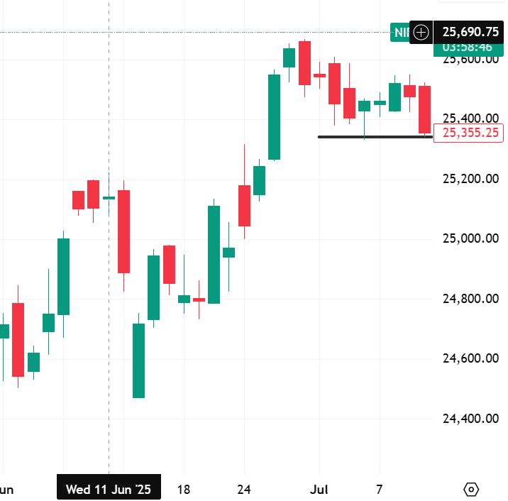
Debit Spread : Bear Put Spread
CMP = 25300
Buy PE 25200 @ 60 (Trade Leg)
Buy PE 25200
Sell PE 25000
Sell PE 25000 @ 30 (Hedge Leg)
Spread : 60 – 30 = 30 (Net Premium)
Max Risk = 30 (Net Premium)
Notes:
Add source, change framing

Slide 14
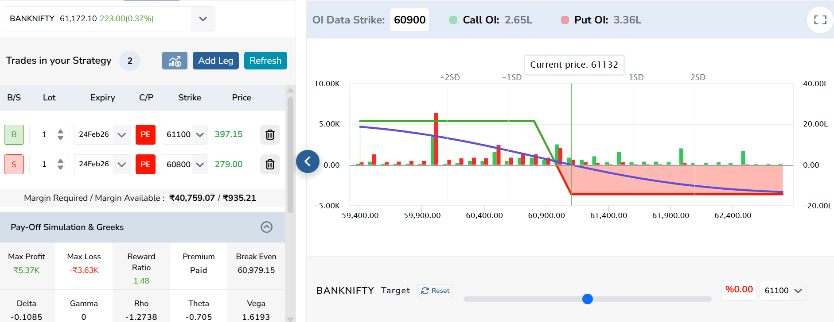
Bear Put Spread : Payoff Chart
Notes:
Add source, change framing

Slide 15
Q & A
Notes:
Add source, change framing

